Slide 1
Matrix Transpose with MapReduce
By
Vivek J D Martins

Slide 2
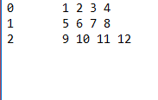
Set Up 1: Creating a Matrix (to test)
Overall Objective: Try a simple matrix transpose example by using MapReduce
1. Open the Terminal
2. Make a directory :
mkdir mattrnps
3. Changing directory to created dir:
cd mattrnps
4. Create some data:
vi Matrix.txt
Press i on keyboard to begin typing into Matrix.txt
( enter row number tab value 1 space value 2 space … etc. new line next row…. etc.)
look at picture for example
Press esc and type :wq (that’s colon then w then q )then hit enter (return)
Type ls to see list of contents in mattrnps ( should look like below)
[cloudera@quickstart mattrnps]$ ls
Matrix.txt

Slide 3
Set Up 2: Creating the Mapper
Create the mapper file:
[cloudera@quickstart mattrnps]$ vi map.py
Press i on keyboard to begin typing
2. Copy Paste the code from the map.py file
Copy paste using mouse (Ctrl+V does not work in terminal)
Then press esc and type :wq then hit enter (return)
3. Change the mode to executable:
(text below is one line)
[cloudera@quickstart mattrnps]$ chmod +x /home/cloudera/mattrnps/map.py

Slide 4
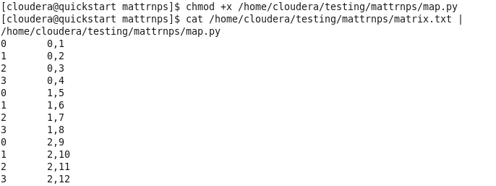
Test the Mapper
Type the following in one line (cat path/matrix.txt | path/map.py) :
[cloudera@quickstart mattrnps]$ cat /home/cloudera/mattrnps/matrix.txt |/home/cloudera/mattrnps/map.py
2. Get O/P as
follows:
Look at image

Slide 5
Set Up 2: Creating the Reducer
Create the reducer file:
[cloudera@quickstart mattrnps]$ vi reduce.py
Press i on keyboard to begin typing
2. Copy Paste the code from the reduce.py file
Press esc and type :wq then hit enter (return)
3. Change the mode to executable:
(text below is one line)
[cloudera@quickstart mattrnps]$ chmod +x /home/cloudera/mattrnps/reduce.py

Slide 6
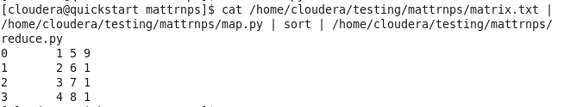
Test output
Type the following in one line
(cat path/matrix.txt | path/map.py | sort | path/reducer.py) :
Please note I have a different path in the image below (should be ‘ /home/cloudera/mattrnps/…’ for you.
cat /home/cloudera/mattrnps/matrix.txt | /home/cloudera/mattrnps/map.py | sort | /home/cloudera/mattrnps/reduce.py

Slide 7
HDFS TIME!!!! Work in Progress (This is the part that failed)
4. Create a directory in the HDFS file system and check the directories
hdfs dfs -mkdir /mattrnps
5. Put the file onto HDFS
[cloudera@quickstart mattrnps]$ hdfs dfs -put /home/cloudera/testing/mattrnps/matrix.txt /user/cloudera/mattrnps
6. [cloudera@quickstart mattrnps]$ hadoop jar /usr/lib/hadoop-mapreduce/hadoop-streaming.jar -input /user/cloudera/mattrnps -output /user/cloudera/output -mapper /home/cloudera/mattrnps/map.py -reducer /home/cloudera/mattrnps/reduce.py

